Slide 1

The 2020 Pandemic: COVID-19 Cases in the United States (U.S.)
Belinda Soerjohadi
Jessica Nguyen
Saki Sugiura
Notes:
S

Slide 2
Why is this important to us?
The virus, coronavirus (COVID-19), is affecting everyone worldwide and nationwide.
During this ongoing pandemic that is continuing to affect us longer than we anticipated, no one knows exactly what COVID-19 is.
How to we prevent spread? Are there trends?
Which part of U.S. is it affecting the most?

Slide 3
Project Description/ Outline
Is there a correlation between income and mortality rate?
What is the mortality rate comparison between the states?
Is there a correlation between state population and number of cases?
Notes:
B

Slide 4
Datasets We Used
Census Data
State Size Data
COVID-19 Data
(New York Times)
https://raw.githubusercontent.com/nytimes/covid-19-data/master/us-states.csv
Notes:
J

Slide 5
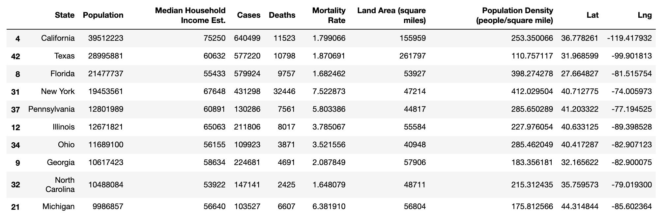
Top 10 Most Populated States by Population
Notes:
S

Slide 6
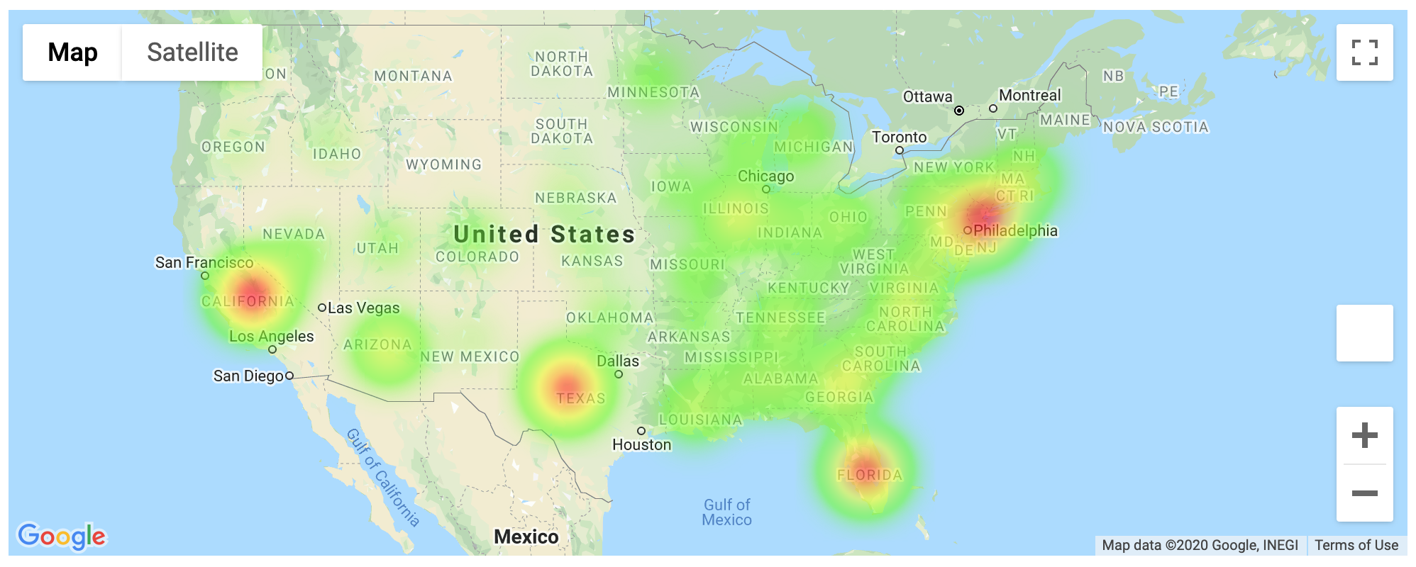
Heatmap of States by Number of COVID-19 Cases
Notes:
B - The heatmap shows the areas with the most COVID-19 cases in the US weighed by number of COVID-19 cases.

Slide 7
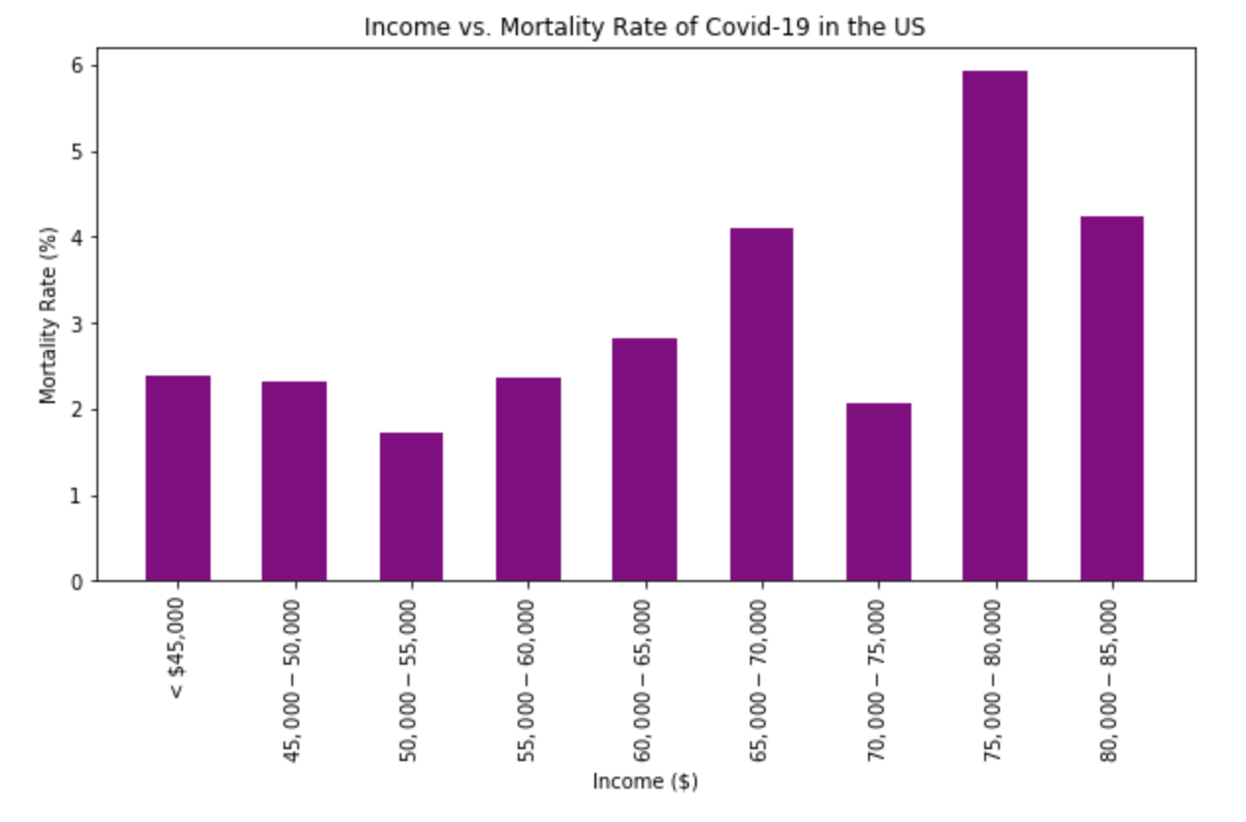
Bar Graph of Income by Mortality Rate (%) of COVID-19 Cases
We used binning to bin the range of median income per state.
Then, we graphed income by mortality rate after grouping by the range of incomes.
Notes:
J - The correlation between income and mortality rate is inconclusive. There is no cure so no one is safe and it’s affecting everyone from all income ranges. **Disclaimer: Average income was taken from 2018 Census, We will need more resources and time to gather more data**

Slide 8
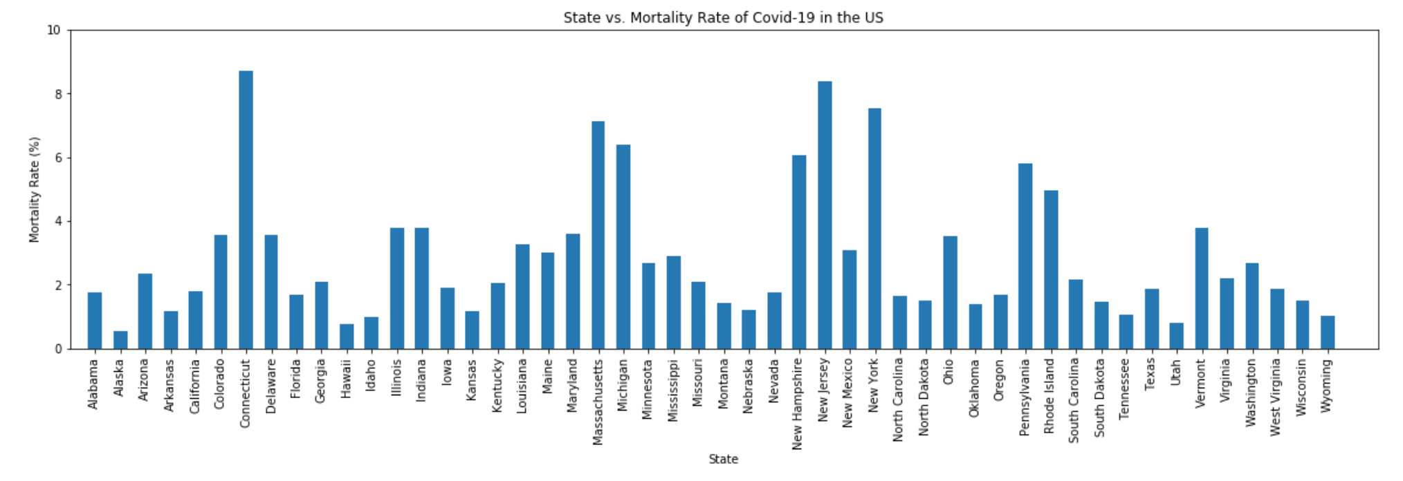
Bar Graph of States by Mortality Rate (%) of COVID-19 Cases
*Mortality Rate (%) Calculated by Death / Number of Cases * 100%
Notes:
S - This bar graph shows the comparison between states and COVID-19 mortality rate. We can visually see that there are higher mortality rates in some states over the other. Furthermore, we can find more data to determine why the mortality rate may be lower for some states over the other. Example: California has one of the most cases but a pretty low mortality rate. Maybe there’s more resources (e.g. more ventilators, more accessible hospitals).

Slide 9
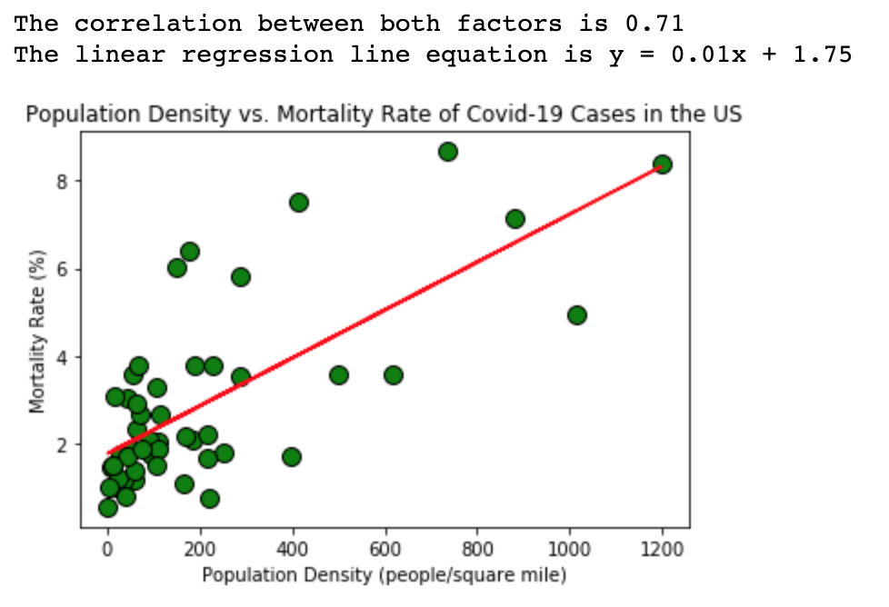
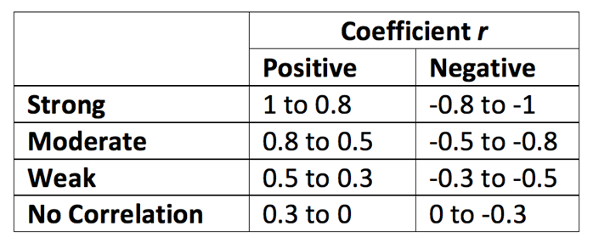
Scatter Plot with Linear Regression Line of Population Density by Mortality Rate
Notes:
B - There is a moderate correlation between state population density and mortality rate. As population density increases, the mortality rate increase. SO, lets take social distancing seriously!

Slide 10
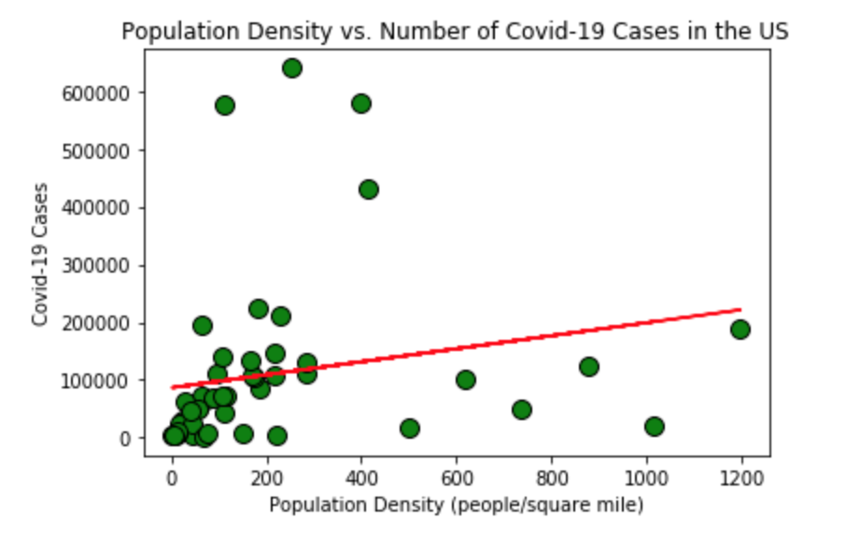
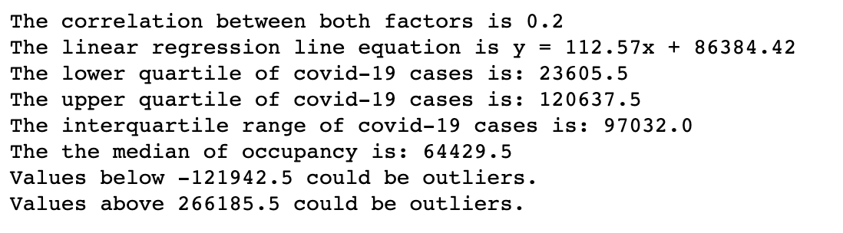
Scatter Plot with Linear Regression Line of Population Density by Number of COVID-19 Cases (with Outliers)
Notes:
J - We plotted the population density for every state by the number of COVID-19 cases. From this, we can see that more cases doesn’t mean higher mortality rate. For example, California.

Slide 11
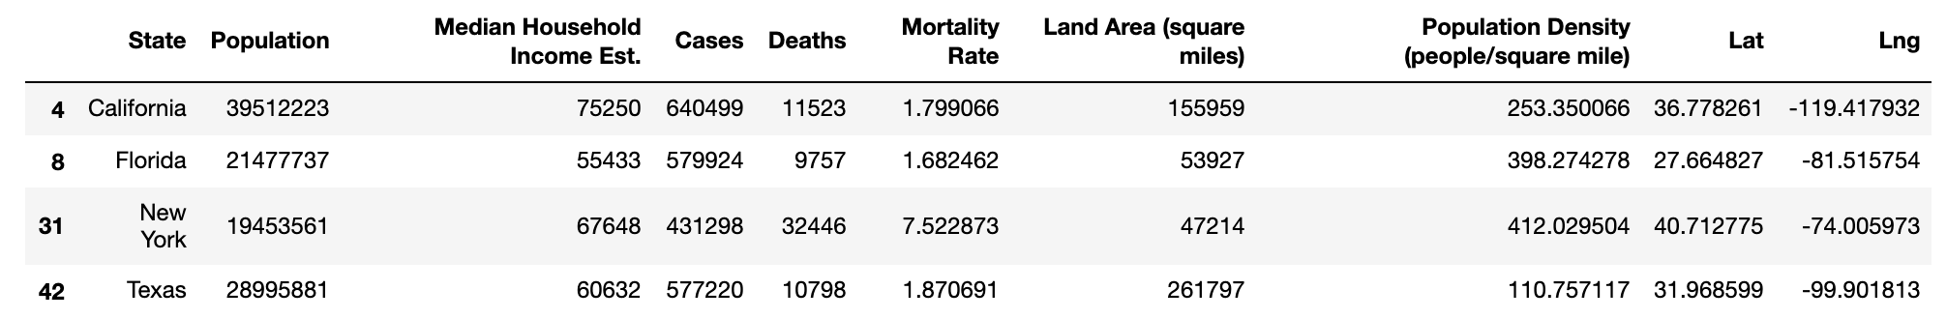
Outliers by Number of COVID-19 Cases
:
Notes:
S - Using the 1.5 IQR rule and we found 4 outliers by the number of cases

Slide 12
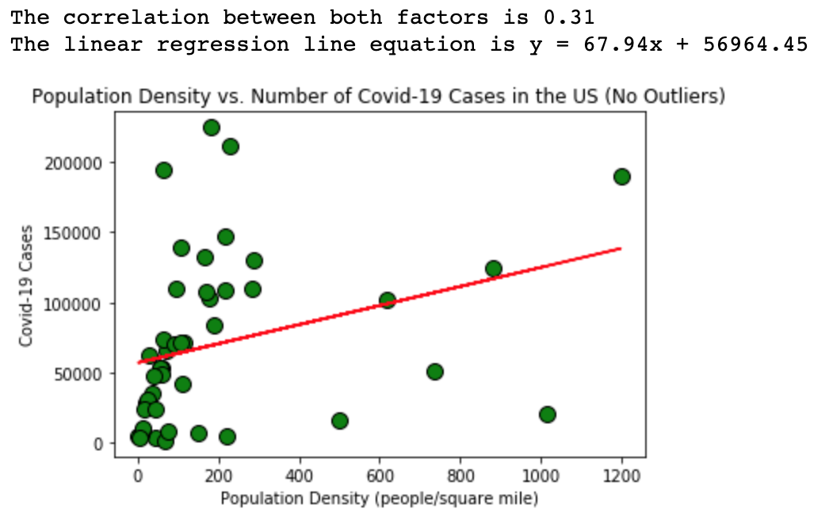
Scatter Plot with Linear Regression Line of Population Density by Number of COVID-19 Cases (without Outliers)
Notes:
B - The correlation coefficient increased slightly and we can see a weak correlation between the population density and the number of COVID-19 cases. As the population density increases, the number of cases increased.

Slide 13
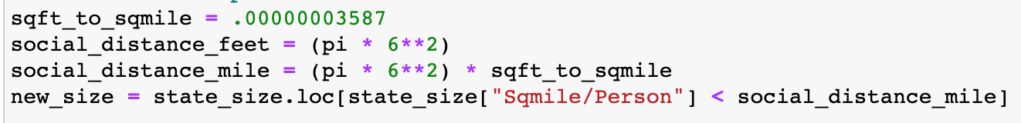
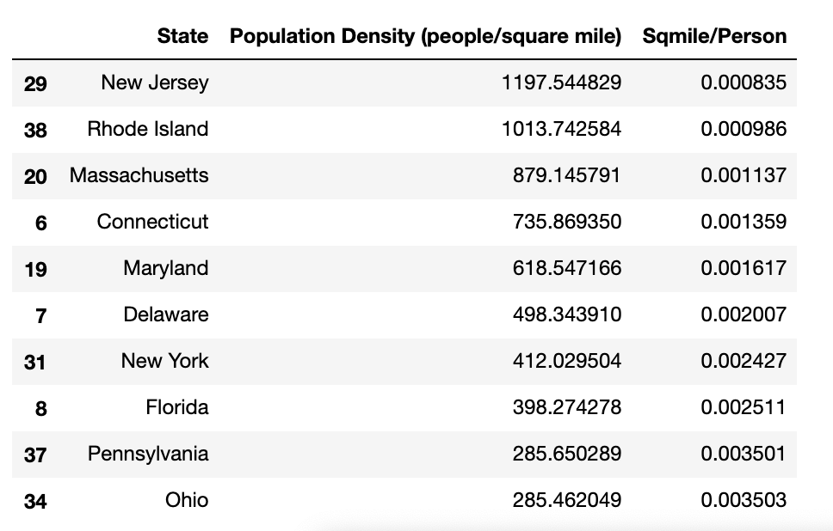
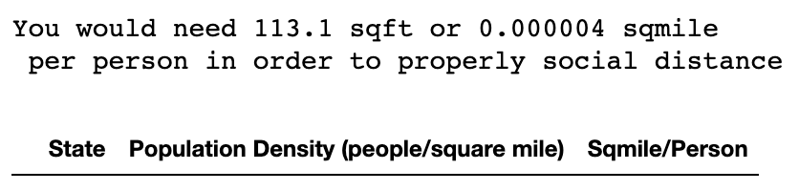
Social Distancing (6 feet)
π * radius ^ 2 = 113.1 square feet
TOP 10 Highest Population Density States:
Notes:
J - We calculated how many square feet (pi * r ^ 2) and converted to square mile a person can occupy in order to properly maintain a 6 feet distance. Our data shows that every state has enough space to social distance

Slide 14
Summary:
There is no correlation between mortality rate and income. COVID-19 is affecting everyone from different income.
Further data gathering: We can narrow down our search by looking at income ranges by taxing brackets (i.g., low, middle, high income) for different counties within a specific state.
There is no correlation between population density and mortality rate.
Further data gathering: We can determine if there’s a correlation between the different variables of states with lower mortality rate (e.g., number of hospitals).
We found a moderate correlation between population density and mortality rate. Social distancing can help prevent death caused by COVID-19 and should be taken seriously.
States to avoid based on them being upper-bound outliers with high number of COVID-19 cases are California, Florida, New York, and Texas.
We found that every state has enough land that everyone can social distance.
Although there are a lot of unknowns of COVID-19, let’s all practice our 6 feet social distancing!

Slide 15
The END!
Notes:
S

